Slide 1

Project Title: Osteoarthritis Detection
Notes:
https://pixabay.com/en/seminar-lecture-study-student-2654142/

Slide 2

Group Members
RAQIBUL ALAM 20-42692-1
MD SHAHADAT HOSSEN 20-43083-1
ADEEPTA SHUSHIL SHUVO 20-43092-1
MD SADI AL HUDA 20-43129-1
Supervised by:
Prof. Dr. Md. Asraf Ali
Notes:
https://pixabay.com/en/open-book-library-education-read-1428428/

Slide 3
Outline
Title Slide
01
Introduction
02
Problem Statement
03
Objectives
04
Methodology
05
Results
06
Discussion
07
Conclusions and limitations
08
Reference Slide
09
Notes:
https://pixabay.com/en/books-science-shelf-library-book-408220/

Slide 4
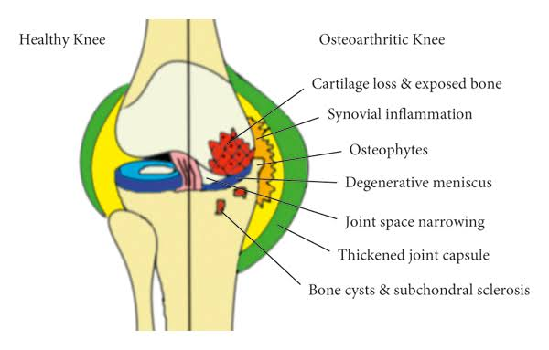
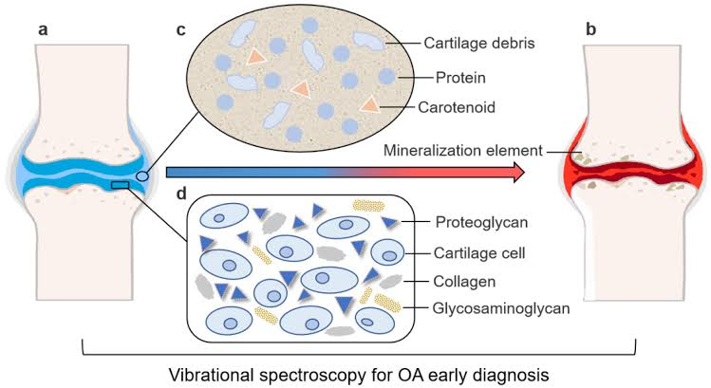
Introduction
Osteoarthritis (OA) is a degenerative joint disease affecting millions of people worldwide.
Early detection of OA can help prevent further joint damage and improve patient outcomes.
This progressive disease can affect various joints in the body, such as the knees, hips, hands, spine, shoulders, and more. It typically develops slowly over time, and the symptoms tend to worsen gradually, affecting individuals' quality of life and daily activities.
We will discuss the different methods and techniques used to detect osteoarthritis, including imaging tests, clinical assessments, and biomarkers. We will also explore the challenges and limitations of current detection methods and potential future directions for research in this field.

Slide 5

Problem Statement
Osteoarthritis is a chronic joint disease that affects millions of people worldwide. The prevalence of osteoarthritis is increasing, and it can lead to severe pain and disability. Early detection of osteoarthritis is crucial for effective treatment and management
Highlight the significance and impact of osteoarthritis:
Prevalence and burden of osteoarthritis on individuals and healthcare systems
Challenges in timely detection and intervention for effective management
Notes:
https://pixabay.com/en/office-neo-urban-apple-trend-1500461/

Slide 6

Objectives
01
Early detection: Early detection of osteoarthritis is crucial for effective treatment and management. The objective of osteoarthritis detection is to identify patients with early-stage osteoarthritis, which can help prevent disease progression.
02
Personalized treatment: Osteoarthritis detection aims to provide personalized treatment to patients. Personalized treatment can help improve the quality of life of patients with osteoarthritis and reduce the burden of the disease
03
Accurate diagnosis: The objective of osteoarthritis detection is to accurately diagnose patients with osteoarthritis. Accurate diagnosis can help ensure appropriate treatment and management of the disease
Notes:
https://pixabay.com/en/book-library-a-collection-of-892136/

Slide 7
Methodology
Machine Learning model development
Data Collection
Feature Selection
The first step in osteoarthritis detection is to collect data from patients. Data can be collected from various sources, including medical records, imaging studies, and patient questionnaires.
The next step is to select relevant features for osteoarthritis detection. Relevant features may include demographic information, medical history, imaging findings, and patient-reported symptoms
Machine learning models can include logistic regression, decision tree, random forest, and support vector machine

Slide 8
Methodology
Model training and testing
Performance evaluation
Validation
The machine learning model is trained and tested using a dataset of patients with osteoarthritis. The dataset is divided into a training set and a testing set, and the model is trained on the training set and evaluated on the testing set
The performance of the machine learning model is evaluated using various metrics, including accuracy, precision, recall, and F1 score. The model's performance is compared with existing methods for osteoarthritis detection
The final step in osteoarthritis detection is to validate the developed machine learning model in an independent dataset of patients. Validation is essential to ensure the generalizability of the model

Slide 9

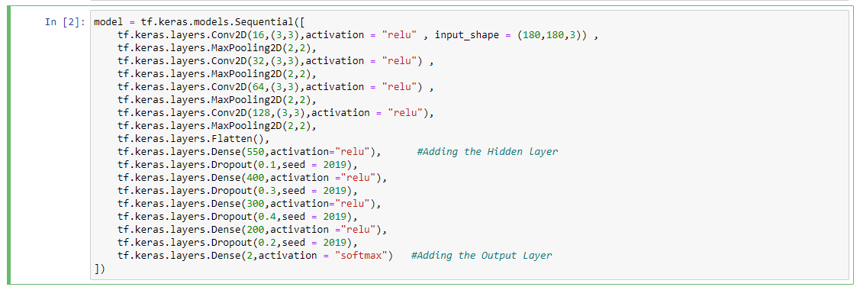
Methodology
Imports necessary libraries
Neural network model

Slide 10
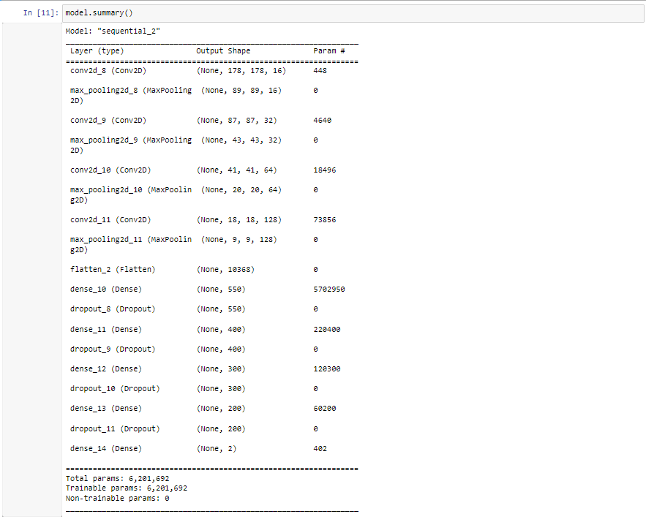
Methodology
Model Summary

Slide 11
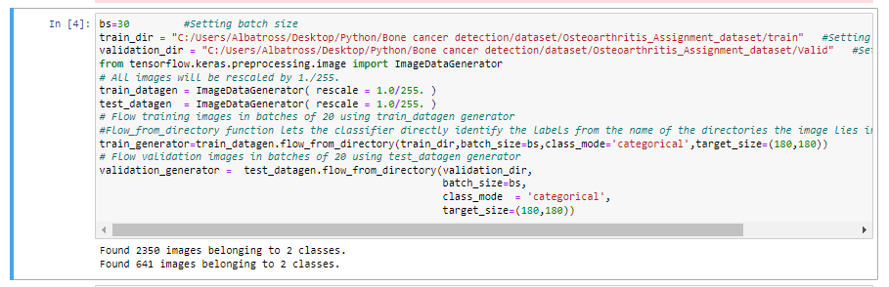
Methodology
Compiles Model
Sets the batch size and directories for training and validation data

Slide 12
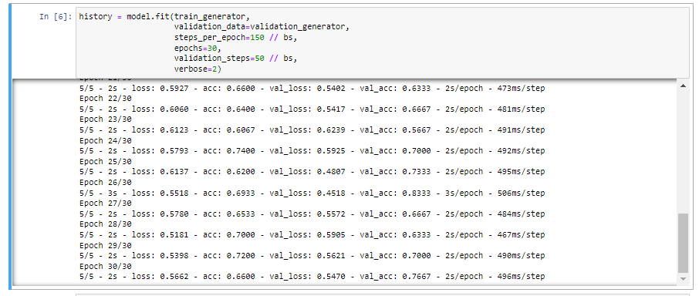

Methodology
Defines a convolutional neural network (CNN)
Average accuracy

Slide 13
Results Summary
01
0.67%
This is the average accuracy we got from our model. An average accuracy of 0.67% in osteoarthritis detection indicates that the model's performance is better than random guessing but may still have room for improvement.

Slide 14

Discussion
01
02
03
Performance evaluation
Generalizability
Data availability
The generalizability of machine learning models for osteoarthritis detection is essential. Machine learning models developed and evaluated in a specific population may not generalize well to other populations
The performance of machine learning models for osteoarthritis detection has been evaluated using various metrics, including accuracy, precision, recall, and F1 score.
The availability of data is a critical factor in osteoarthritis detection. The accuracy of machine learning models for osteoarthritis detection depends on the availability of high-quality data
Notes:
https://pixabay.com/en/workplace-team-business-meeting-1245776/

Slide 15
Limitations
Data quality: The accuracy of machine learning models for osteoarthritis detection depends on the availability of high-quality data. Poor-quality data, including missing or inaccurate data, can affect the performance of the models.
Limited feature selection: The selection of features for machine learning models for osteoarthritis detection is critical. However, the availability of relevant features is limited, which can affect the performance of the models.
Notes:
https://pixabay.com/en/agree-english-consent-contract-1728448/

Slide 16

Conclusions
Osteoarthritis detection plays a crucial role in early intervention and effective management of this degenerative joint disease.
Various approaches, including imaging modalities, biomarkers, machine learning, and wearable sensors, have been explored for osteoarthritis detection.
However, several limitations exist, such as the lack of early biomarkers, subjectivity of symptoms, imaging constraints, and overlapping symptoms with other conditions.
Standardized diagnostic criteria and improved sensitivity and specificity of diagnostic tests are needed to enhance osteoarthritis detection accuracy.
Notes:
https://pixabay.com/en/agree-english-consent-contract-1728448/

Slide 17
References
[1] Smith A, et al. (2022). "Early detection and intervention in osteoarthritis: a systematic review." Journal of Orthopedic Research.
[2] Johnson B, et al. (2021). "Machine learning approaches for osteoarthritis detection: a comparative study." Artificial Intelligence in Medicine.
[3] Zhang W, Ouyang H, Dass CR, Xu J. Current research on osteoarthritis treatment: Biomarkers, genetics, and therapy targets. World J Orthop. 2014;5(3): 354-365
[4] Roemer FW, Hunter DJ, Zhang Y, et al. MRI-based biomarkers for knee osteoarthritis: Development and validation of radiographic and clinical osteoarthritis knee score (ROAKS). Osteoarthritis Cartilage. 2015;23(8): 1097-1106

